Slide 1

Portfolio Time
Presented by:
Lucas Wilkins

Slide 2

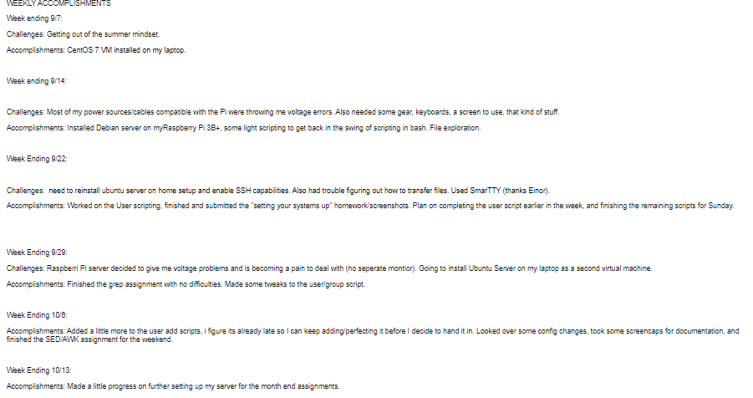
Challenges and What-Not

Slide 3

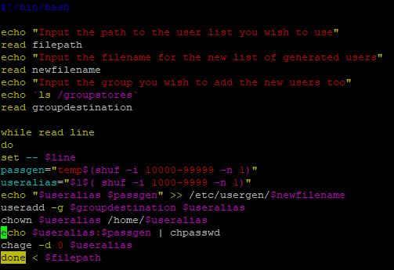
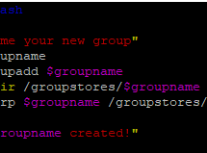
Scripts !
Making the computer do stuff for us and hoping it doesn’t become self-aware.

Slide 4

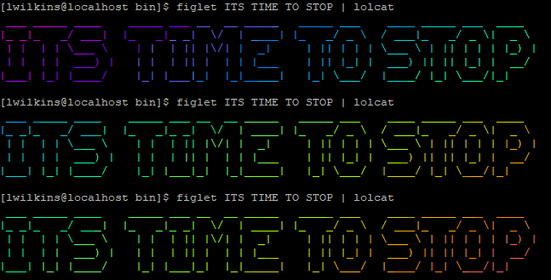
TOOLS
TMUX
EMACS
Fail2Ban
>figlet/cowsay/lolcat<

Slide 5

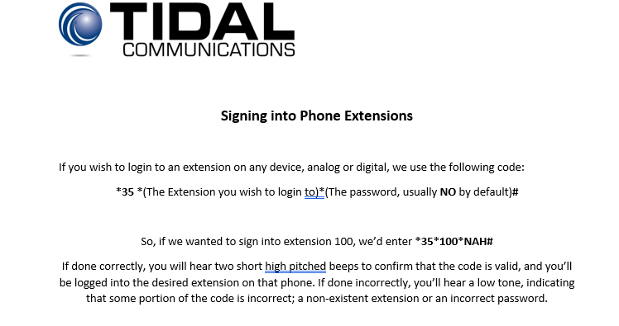
Docs for Customers

Slide 6
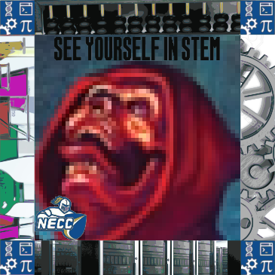
!Design!
*graphic design is my passion :^)*

Slide 7
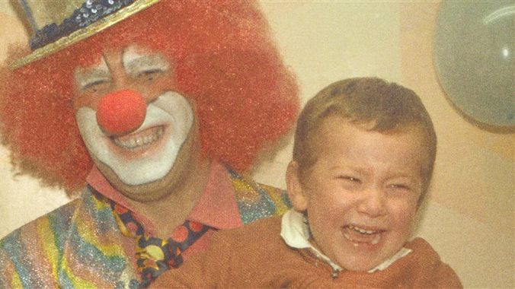
This is the part where I go through my github
https://github.com/MisterMahjong

Slide 8
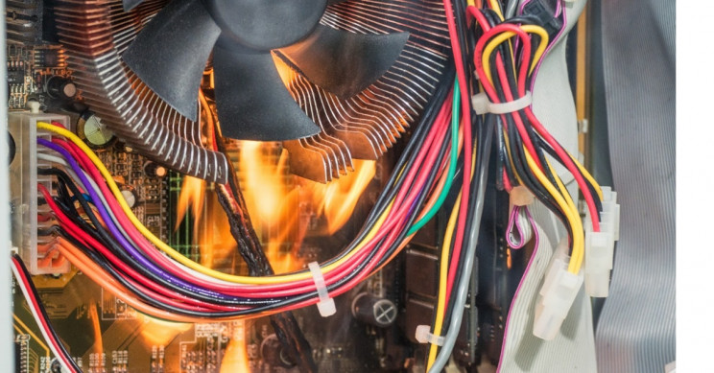
Thanks !
I did my best

